Slide 1


Slide 2
Index
Abstract _______________________________________03
Stakeholder Need & Objective____________________04
Data and Methodology___________________________ 06
Import data to SQL database______________________07
ER-DIAGRAM____________________________________08
Structure & Content of Table______________________09
Subquery_______________________________________14
JOIN___________________________________________17
CTE___________________________________________ 20
Impact_________________________________________24
Recommendation________________________________25
Q&A___________________________________________26

Slide 3

ABSTRACT
This project was undertaken to provide key insights into student performance and topic popularity within an educational platform.

Slide 4

Stakeholder Needs and Objectives
Understanding Student Distribution:
They wanted to know the geographical distribution of students and how students were spread across different grades. This information was crucial for resource planning and ensuring equitable access to educational materials.
Measuring Student Success:
They aimed to track student progress and identify factors influencing success, such as topic completion rates and test scores.

Slide 5
Stakeholder Needs and Objectives
Evaluating Topic Effectiveness:
Stakeholders needed to assess the popularity and difficulty of different topics. This would help them identify areas where students struggled and where curriculum adjustments might be necessary.
Optimizing Resource Allocation:
By analyzing student enrollment trends over time, stakeholders could make informed decisions about staffing, budgeting, and facility planning.

Slide 6
Data and Methodology
The analysis was conducted using SQL queries against a database named "student information." This database contained several tables, including:
date_date: Information about dates (day, month, quarter, year).
city_region: Details about student locations (city, state).
topic_topic: Information about available topics (topic ID, topic name, grade).
student_topic: Records of student interactions with topics (student ID, topic ID, test cleared status, percentage mark).
Student_student: Student demographics (student ID, student name, grade, class start date, test date).

Slide 7





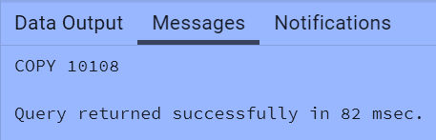

Import data to SQL database
Prepare csv file
Create tables in SQL
Import csv file into SQL

Slide 8
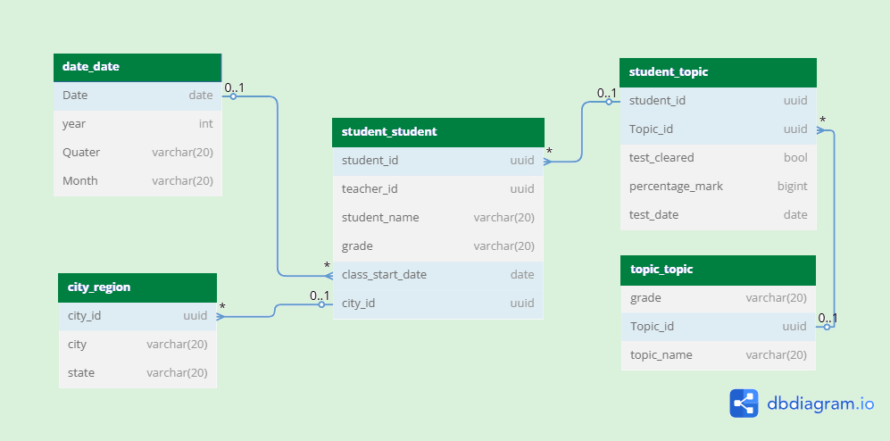
ER- DIAGRAM
ERD is the backbone of any well-structured database design. It helps visualize how different entities (tables) interact with each other, ensuring data integrity, efficiency, and scalability.

Slide 9
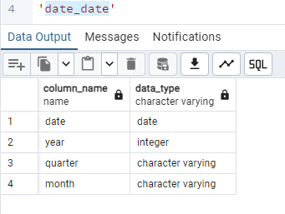
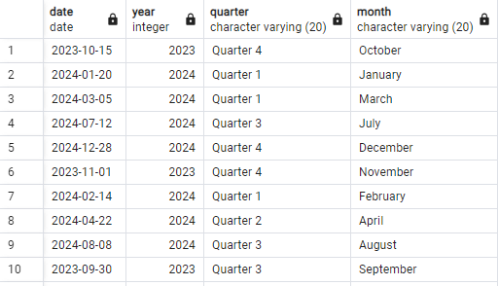
Structure & Content of Table

Slide 10
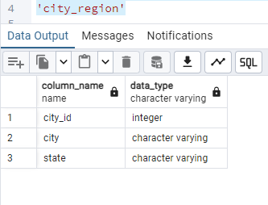
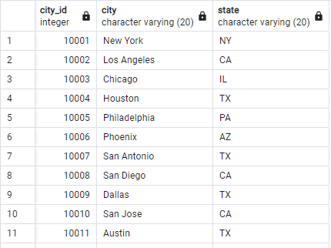
Structure & Content of Table

Slide 11
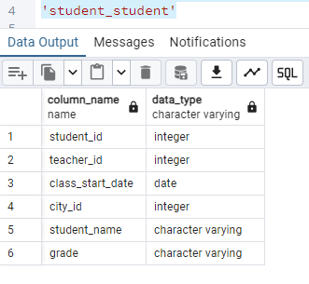
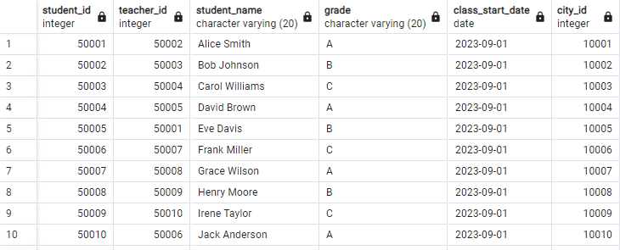
Structure & Content of Table

Slide 12
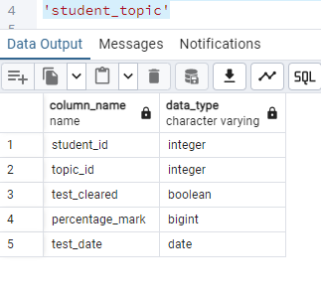
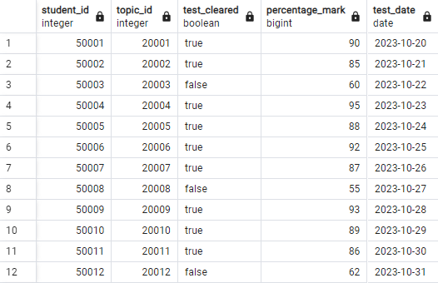
Structure & Content of Table

Slide 13
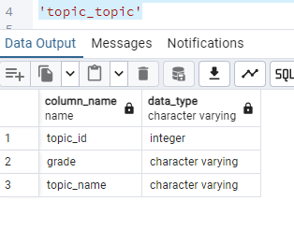
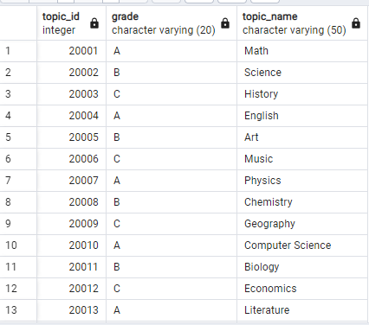
Structure & Content of Table

Slide 14

SUBQUERY

Slide 15
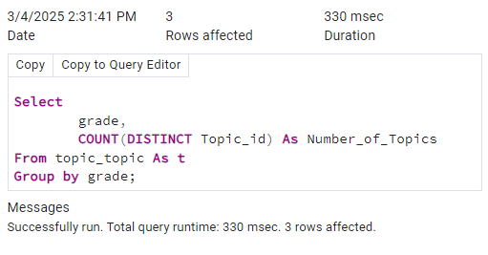
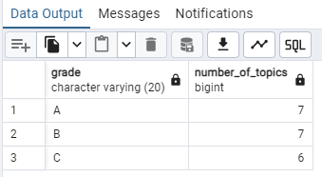
How many topics are available in each grade? Display grade, number of topics in each grade.
Grades A and B offer a slightly broader range of topics compared to Grade C.

Slide 16
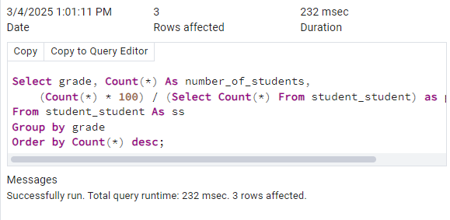
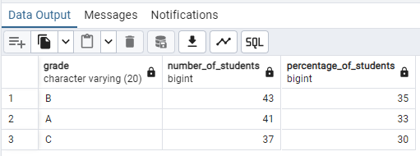
Show the distribution of students across grades. Display the grade and number of students in each grade, % students in each grade.
Grade B has the highest student enrollment, followed closely by Grade A, indicating a relatively even distribution across all three grades

Slide 17
JOINS

Slide 18
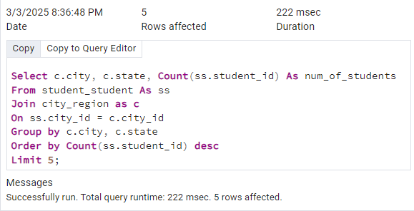
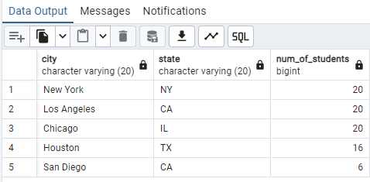
List the top 5 cities in terms of number of students. Display the names of cities, states and number of students in each city.
Student enrollment is heavily concentrated in major US cities, particularly New York, Los Angeles, and Chicago.

Slide 19
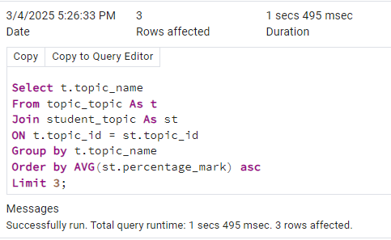
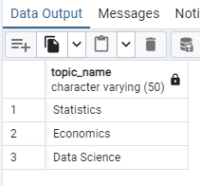
List the top 3 topic in terms of difficulty level.
Statistics, Economics, and Data Science present the greatest academic challenges based on student performance.
These topics may require focused attention and resources to improve student understanding and outcomes.

Slide 20
CTE

Slide 21
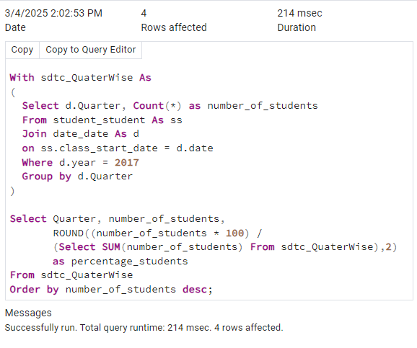
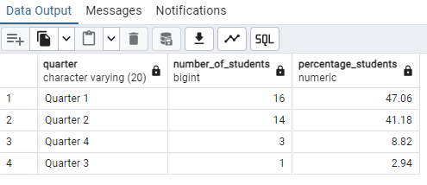
List our most successful quarter in terms of new students added Display all quarters of 2017, count and % students who started class.
Student enrollment peaked in the first quarter of 2017, significantly outpacing all other quarters

Slide 22
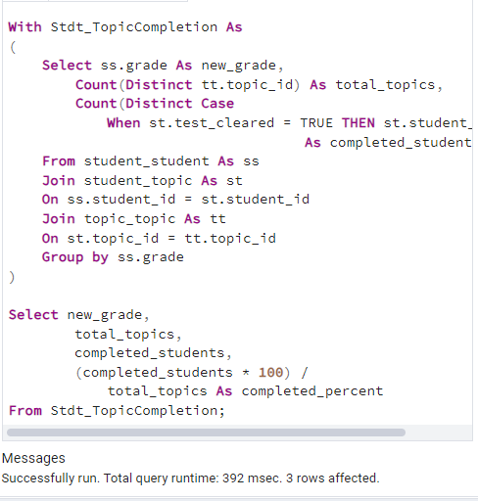
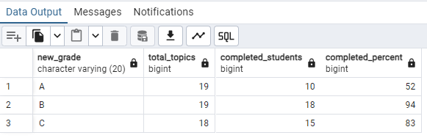
What percentage of students completed all topics in the grade? Display grade, number of topics number of students who have completed all topics.
Grade B students show the highest completion rate of all topics, significantly outpacing Grades A and C.
While all grades have a similar number of total topics, completion percentages vary widely, indicating potential differences in student engagement or topic difficulty.

Slide 23
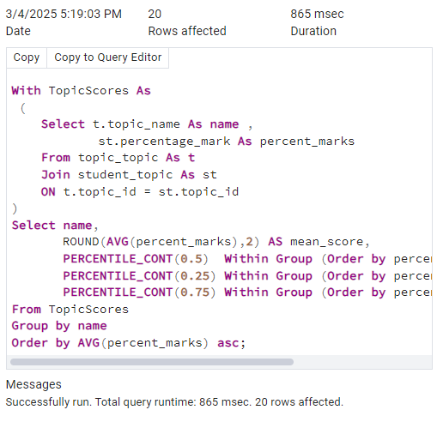
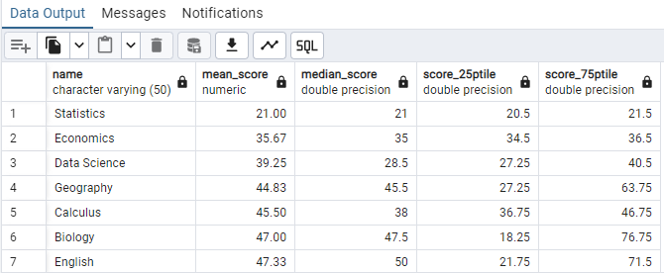
Identify topics that have least scores. Display all topic names, mean, median, 25th and 75th percentile marks for each.
Statistics and Economics show the lowest average scores, indicating potential areas for curriculum review or additional student support.
Conversely, Psychology and Programming exhibit the highest average scores, suggesting strong student performance in these topics.

Slide 24
Impact
Uneven geographical distribution: A significant concentration of students in major urban centers (New York,
Los Angeles, Chicago) may lead to disparities in resource allocation and access to educational opportunities.
Varied topic completion and performance: Differences in topic completion rates and test scores across grades and topics suggest potential challenges in student engagement, curriculum effectiveness, or access to support.
Challenging topics: Statistics, Economics, and Data Science emerge as particularly challenging topics, indicating a need for focused attention and intervention.
Fluctuating enrollment: Enrollment trends, such as the peak observed in the first quarter of 2017, highlight the need for dynamic resource allocation and planning to accommodate changing student numbers.

Slide 25
Recommendations
Prioritize equitable resource allocation: Ensure that resources, including staff, materials, and technology, are distributed equitably to address the needs of students in all locations, with particular attention to urban centers with high student density.
Enhance student support: Implement targeted intervention programs, additional tutoring, and academic support resources to address the challenges faced by students in specific grades or with particular topics.
Review and adjust curriculum: Conduct a thorough review of the curriculum, especially for topics with low completion rates or poor test performance, to identify areas for improvement in clarity, engagement, and alignment with student needs.
Optimize resource utilization: Leverage enrollment trend data to inform staffing, budgeting, and facility planning decisions, ensuring that resources are aligned with student needs and enrollment patterns.
Promote data-driven decision making: Encourage the use of data analysis and insights to guide decision-making across all levels of the institution, fostering a culture of continuous improvement and responsiveness to student needs.

Slide 26
Q&A

Slide 27
Thanks!
Do you have any questions? mk204009@gmail.com
+8368853313

